Slide 1
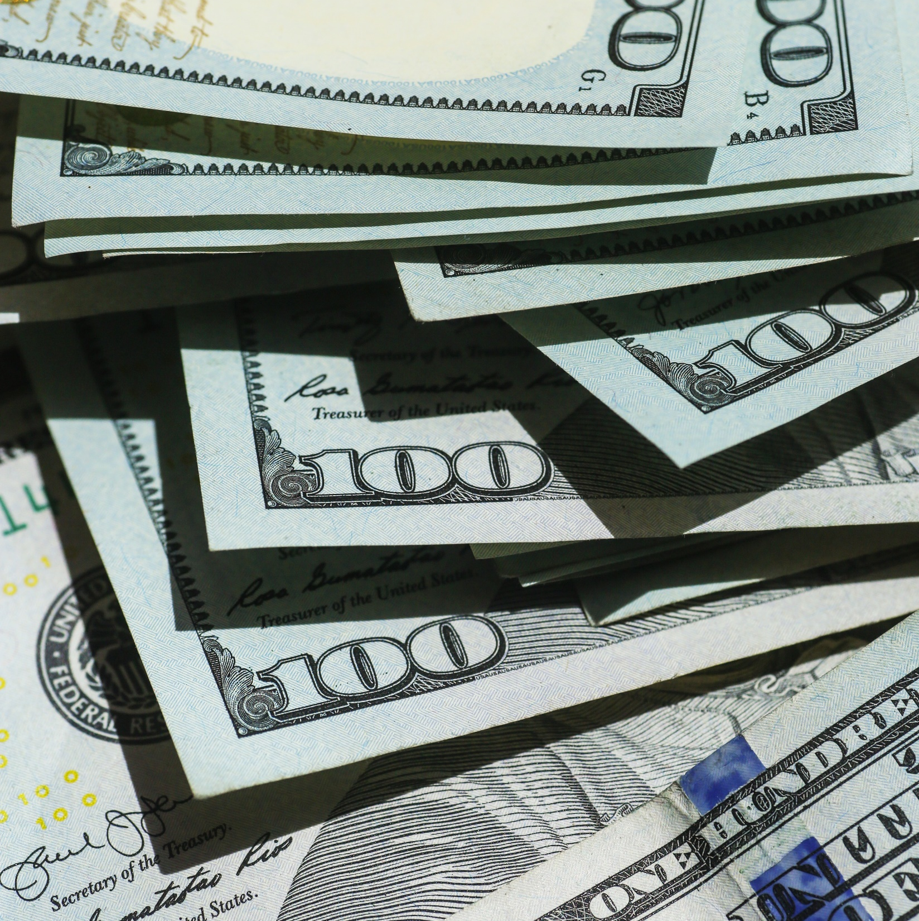
Fraud Detection Model
Mobile Money Transaction

Slide 2
Segment’s in approaching a Model

Slide 3

Initial Stage
Gathering of
Data.
Understanding and analysis.
Implementation planning

Slide 4

MIDDLE STAGE
Explorative Data Analysis
Feature Engineering
Feature Selection
Physical Design

Slide 5

LAST STAGE
Development
Evaluation
Monitoring and performance tuning
Deployment

Slide 6

Different Approach
Initial Stage Last Stage
Middle Stage

Slide 7
Dataset Used (Kaggle)
Synthetic Financial Datasets for fraud detection (Generated by PaySim mobile money generator).
https://www.kaggle.com/datasets/ealaxi/paysim1

Slide 8

Software Used
Jupyter Notebook

Slide 9
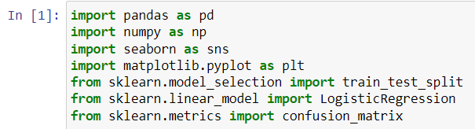
Rule of Thumb (Common Libraries)

Slide 10
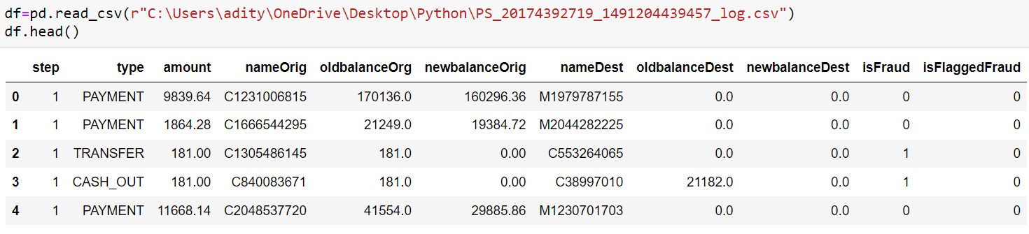

Importing the data and Validating the shape
pd.read_csv = Used for reading the data or giving a source file extension.
df.head () (Appointed into the pd.read_csv input) = User for importing the data.
df. shape = Used for checking the total number of rows and columns (Rows = 6362620
Columns = 11)

Slide 11
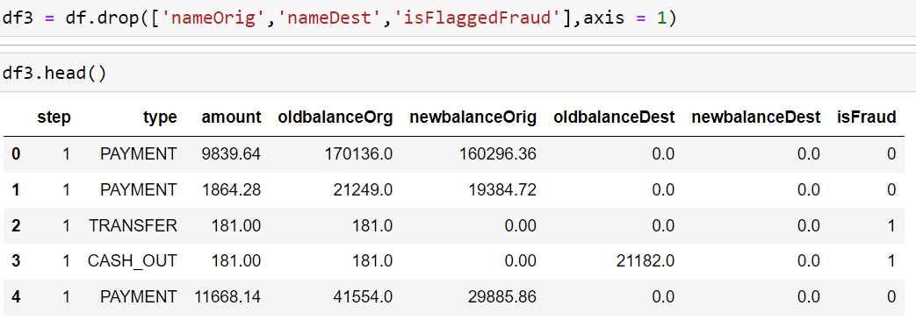
Dropping Character Variables
Dropping of the unwanted variables which are not required in terms of logistic regression.
Putting the axis as 1 in terms of column.
Storing of the data in df3.
Using df3.head to show the output
Ignoring the dropping of TYPE column as the dropped columns were mostly id variables whereas the type column is not.
The TYPE column defines a category of the data.

Slide 12
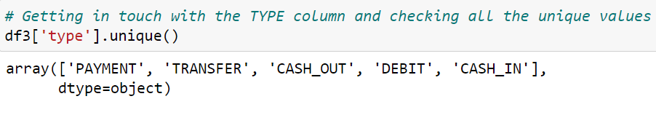
Treating the TYPE Variable
Finding the Unique Values of the TYPE variable.
Five Unique Values mentioned in the TYPE variable [ Payment , Transfer , CASH_OUT , Debit , CASH_IN ]
Every element having it’s own specification and data as mentioned in the dataset provided.

Slide 13
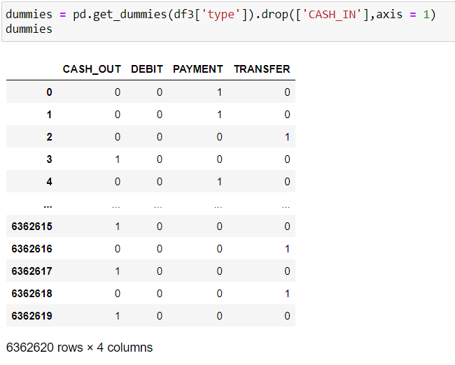
One Hot Encoding
Alloting Numbers to every unique value mentioned in the TYPE column.
Separating the amount’s from these unique values help in getting a clear view.
Wherever there is an intersection in these columns 1 is added to that column.
Rest all the columns remain 0.

Slide 14
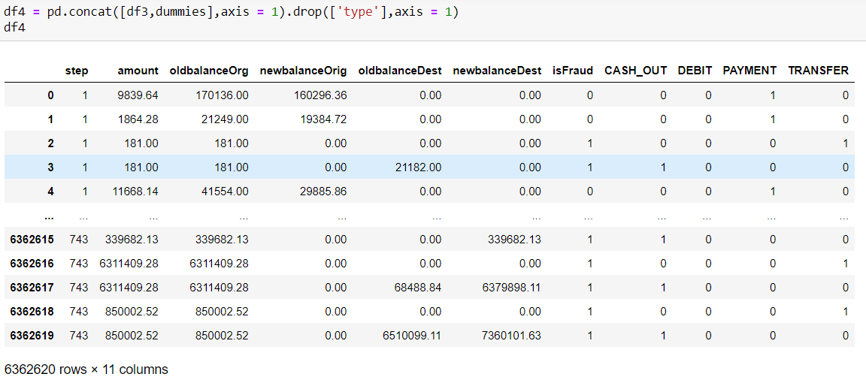
Concatenation
Concatenation help’s in giving a brief look of the entire data mentioned.
Mainly carried out after deletion of CASH_IN column.
Help’s in joining the table directly to the dataframe.

Slide 15
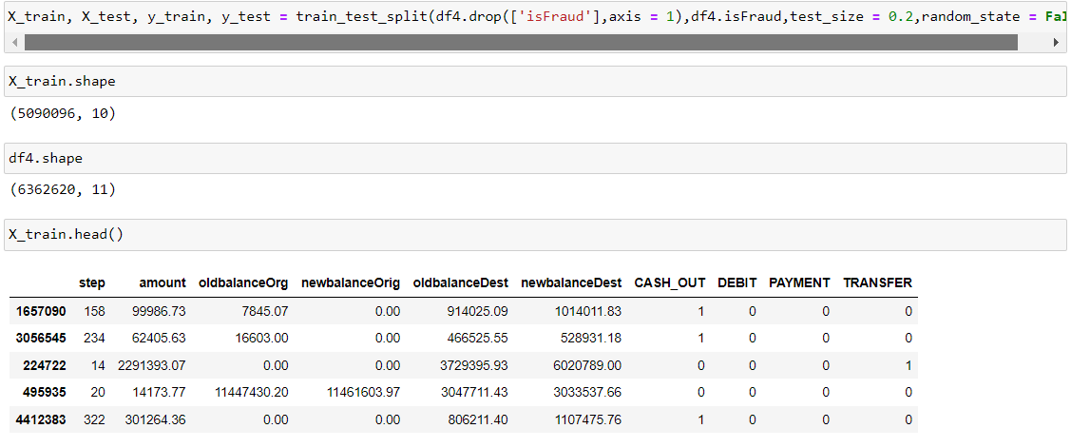
Model Development
Step 1) Getting in touch with the dependent and independent variables.
Step 2) All the variables mentioned in the above slide are independent except the isFraud variable as mentioned in the picture.
Step 3) Separating the isFraud variable and putting the rest of the variables together will help in getting a brief look of the data mentioned.
Step 4) Using the train_test_split function in this case to give a starting point in development of the particular model.
Step 5) Checking the shape of the training data as well as the df4 data mentioned.

Slide 16
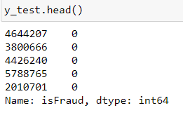
Test Method View
Dependent Variable View

Slide 17
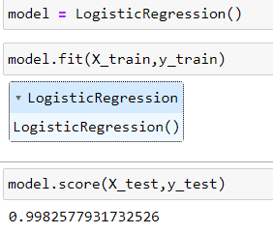
Creation of the Model
Creating the logistic regression model and getting the prediction percent of the model showing
99% perfection.
Fitting the model and checking of the score in such case.
99% prediction is mainly happening due to the unbalanced data mentioned in the dataset.

Slide 18
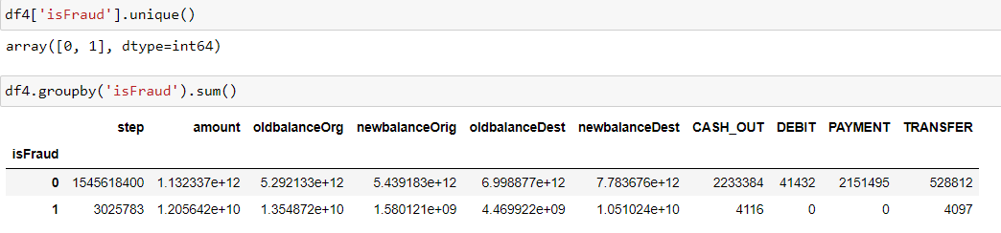
Unbalanced Dataset, Why?
Finding out all the unique values from the isFraud variable column and grouping them before
finding the sum.
After checking the values mentioned in the STEP column we can see how disturbed and imbalanced the data is.
This show’s that the prortion is too low and gives us a brief of the possibility level of a fraud taking place.
Thus the prediction of the data is 99%

Slide 19
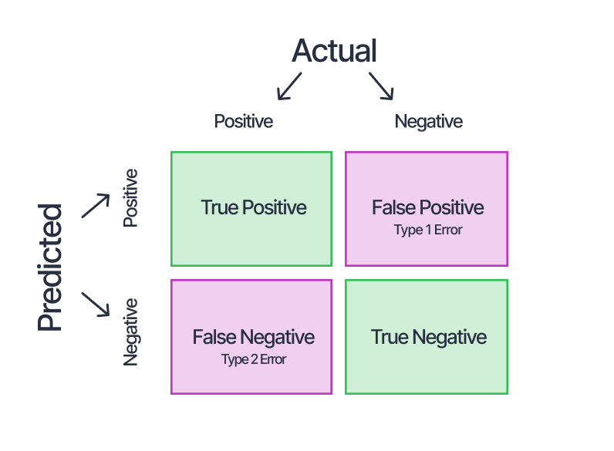
Confusion Matrix
A 2x2 table where at X axis we put the predicted methods whereas on the Y axis we put the actual’s .

Slide 20
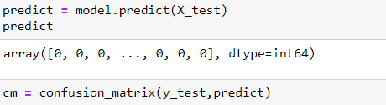
Predicting the model and implementing the confusion matrix as mentioned in the above picture.
X_test dataset is stored in a variable named PREDICT.
Prediction in this case is done to use in the confusion matrix mentioned above.
Storing it in a variable named cm.

Slide 21

Heatmap Plot Creation

Slide 22
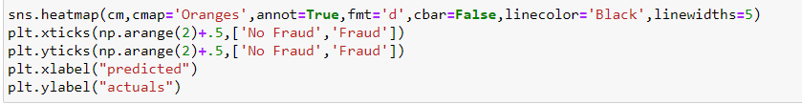
Creation of a heatmap plot named sns.heatmap and adding a variable cm to the particular heatmap.
Addition of colours to the particular heatmap for it to look more accurate using cmap = ‘oranges’.
Adding number’s to the heatmap by using the annot.
To add readable numbers the fmt = ‘d’ parameter is used, in this ‘d’ stands for DIGIT.
Dropping of the column to make the heatmap look better using the cbar = false method.
Addition of the rest palettes to make the heatmap look readable.

Slide 23
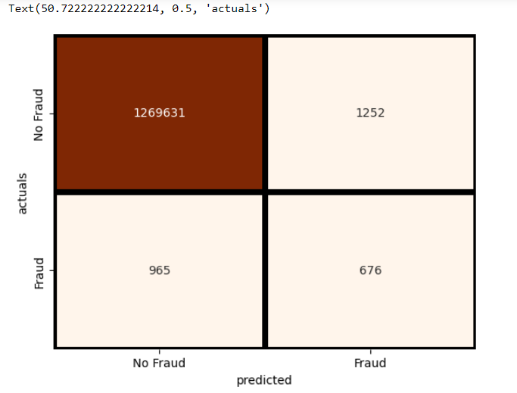
In the diagram generated, mostly less than 50% of the frauds are TRUE NEGATIVE.
Whereas the rest are FALSE NEGATIVE.
The 99% prediction is because of the highest numbered area shown in DARK BROWN colour.
This model is mostly predicting the Data to be NO FRAUD.
This is mainly creating the largest volume in our data thus showing the prediction of 99%.

Slide 24

Thank YOU
Name – Aditya Tikone

